Slide 1
Project 1
Alexis Montes, Julien Bankier, Jared Kopeloff, Komal Narine

Slide 2
Roles
Julien Bankier: Project Manager, In charge of the powerpoint (putting it together from the individual slides), fixing team queries, and individual queries.
Komal Narine: In charge of the JDBC Driver, fixing team queries, and individual queries.
Alexis Montes: In charge of video editing, fixing team queries, and individual queries.
Jared Kopeloff: In charge of submission, formatting the file properly, and individual queries.

Slide 3
Project Tracking

Slide 4
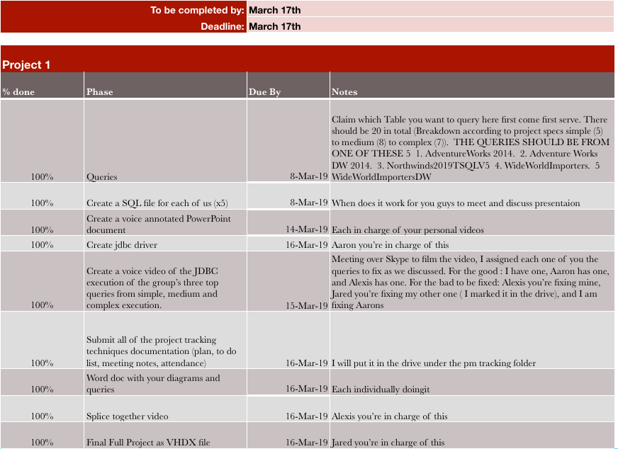
To Do List
*Can be found in the submissions file in the folder PM Tracking

Slide 5
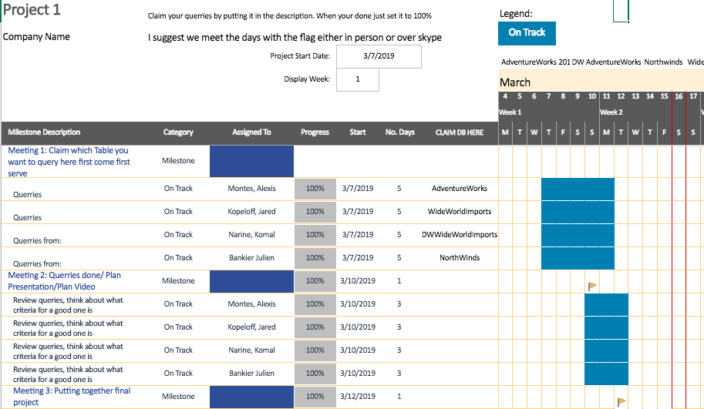
Project 1 Plan
*Can be found in the submissions file in the folder PM Tracking

Slide 6
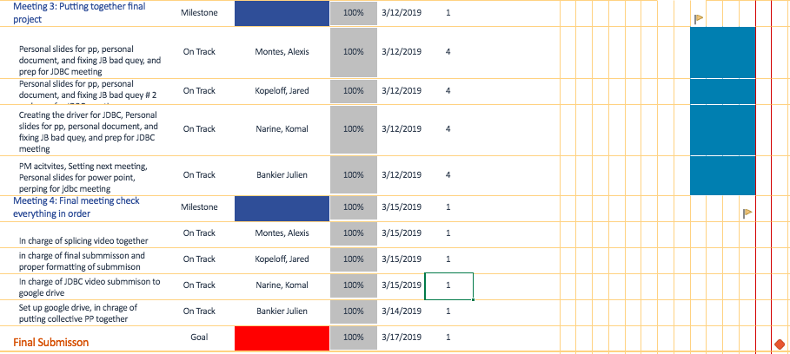
Project 1 Plan
*Can be found in the submissions file in the folder PM Tracking

Slide 7
Group Meetings - Summary
Meeting 1: Initial start up of project. Set up long term milestones and first week goals
Date : 3/6/2019
Attendance: Jared Kopeloff, Alexis Montes, Komal Narine, Julien Bankier
Minutes: a.) Set up meeting time for next time b.) Decide the roles c.) Decide how to move forward in coming weeks
Meeting 2: Set up next goal and discussed any query issues
Date : 3/10/2019
Attendance: Jared Kopeloff, Alexis Montes, Komal Narine, Julien Bankier
Minutes: a.) Discuss any issues with queries b.) Quick touch base

Slide 8
Group Meetings - Summary
Meeting 3: Queries are now finished, discussed how we would do the video, divvied up the work according to strengths of the group
Date : 3/12/2019
Attendance: Jared Kopeloff, Alexis Montes, Komal Narine, Julien Bankier
Minutes: a.) Assign someone to do the JDBC b.) Decide how we will film videos c.) Begin thinking about what a good query is
Meeting 4: Picked the top 3 and worst 3 queries, assigned each one 3/14
Date : 3/14/2019
Attendance: Jared Kopeloff, Alexis Montes, Komal Narine, Julien Bankier
Minutes: a.) Set the criteria for a good query b.) set date for jdbc video google hangout c.) pick best three and worst three and decide who would fix
Meeting 5: Filmed video for jdbc, discussed any issues 3/15
Date : 3/16/2019
Attendance: Alexis Montes, Komal Narine, Julien Bankier
Minutes: a.) Film the jdbc video

Slide 9
Queries by Student

Slide 10
Julien Bankier – Individual Queries
* The following Queries are all performed on the NorthWinds Database

Slide 11
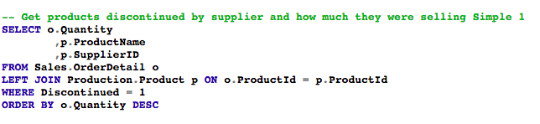
Simple Query 1
Proposition: A business wants to know which products are discontinued and how much they were selling for.
Query:

Slide 12
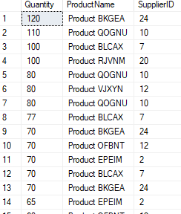
Query in depth
Why: A business may want to see what products were once selling well that have been discontinued and find a replacement supplier
Query Result:

Slide 13
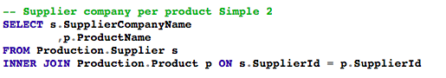
Simple Query 2
Proposition: A business wants to know which products are being supplied by which company
Query:

Slide 14
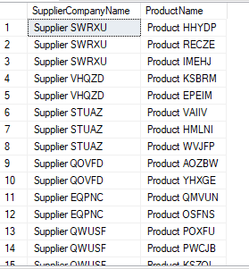
Query in depth
Why: A business may want to see which supplier is supplying what product
Query Result:

Slide 15
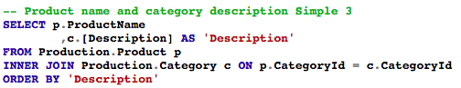
Simple Query 3
Proposition: A business wants to know the description of the category of each product
Query:

Slide 16
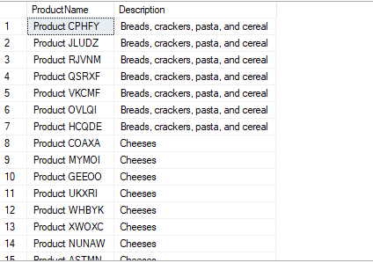
Query in depth
Why: A business may want to see each item, and the category description for an item
Query Result:

Slide 17
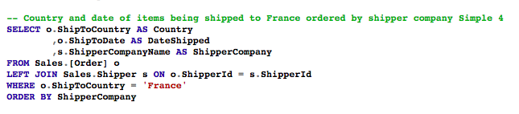
Simple Query 4
Proposition: A business wants to see which company is shipping product to France
Query:

Slide 18
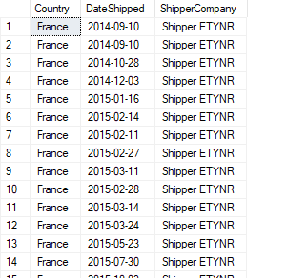
Query in depth
Why: A business may need to leverage this information in order to see if they can cut cost by either combining shipments to France or using one shipping company over another
Query Result:

Slide 19
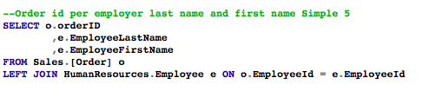
Simple Query 5
Proposition: A business wants to see what order was booked by which employee
Query:

Slide 20
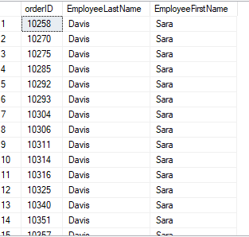
Query in depth
Why: A business has a need to track which employee booked each order, if something goes wrong with an order it can easily see which employee is most familiar with the situation
Query Result:

Slide 21
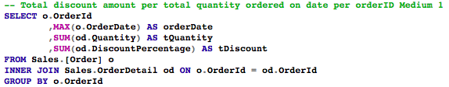
Medium Query 1
Proposition: A business wants to see the total discounted being applied to their sales
Query:

Slide 22
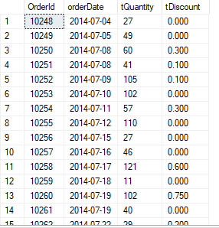
Query in depth
Why: If a business wants to reexamine it's profit and potentially change how much discount is being offered this query could help figure out what products to do so on
Query Result:

Slide 23
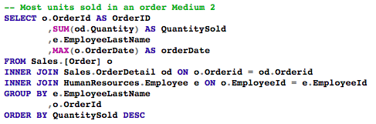
Medium Query 2
Proposition: A business wants to know the most units sold in a single order
Query:

Slide 24
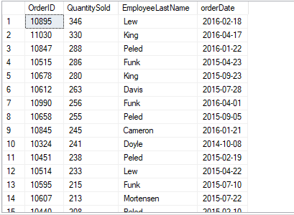
Query in depth
Why: A business may want to figure out what clients are ordering a lot in order to target them
Query Result:

Slide 25
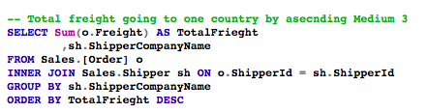
Medium Query 3
Proposition: A business wants to know the total freight going to each country
Query:

Slide 26
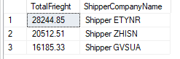
Query in depth
Why: A business could use this information to consolidate cost on shipping or attempt to make a better deal with a particularly company on a specific shipping route
Query Result:

Slide 27
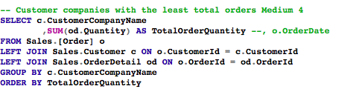
Medium Query 4
Proposition: A business wants to know what company is ordering the least amount of items
Query:

Slide 28
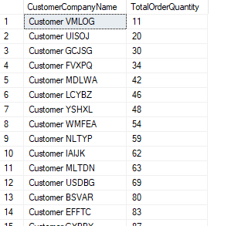
Query in depth
Why: A business can use this information to concentrate it's efforts on getting more sales from the lower buying companies
Query Result:

Slide 29
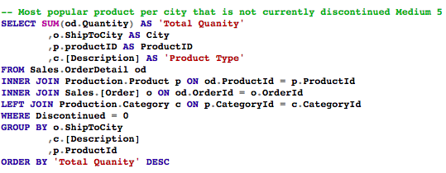
Medium Query 5
Proposition: A business wants to know what it's most popular products are per city
Query:

Slide 30
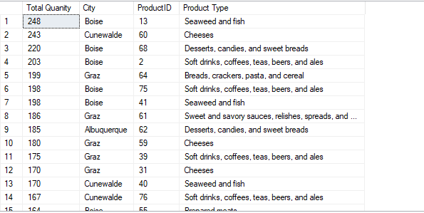
Query in depth
Why: A business would want to know what products are popular where
Query Result:

Slide 31
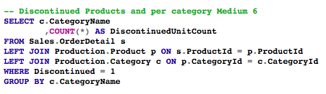
Medium Query 6
Proposition: A business wants to see what products are discontinued per category
Query:

Slide 32
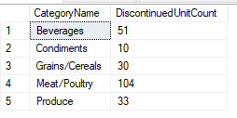
Query in depth
Why: A business may want to increase the amount of products of that type that it has if it notices a lot of products have been discontinued
Query Result:

Slide 33
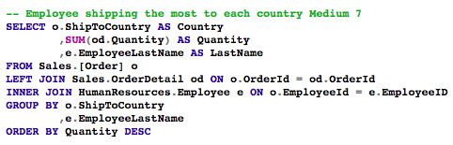
Medium Query 7
Proposition: A business wants to know what employee is selling the most to what country
Query:

Slide 34
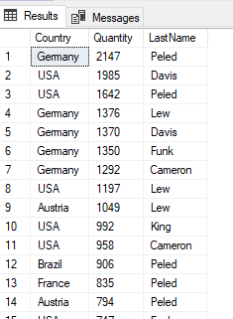
Query in depth
Why: If an employee is selling a lot to a client or country a business can leverage that to create new clients through that employee
Query Result:

Slide 35
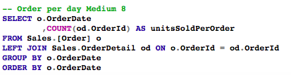
Medium Query 8
Proposition: A business wants to know the amount of orders per day
Query:

Slide 36
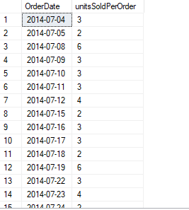
Query in depth
Why: A business can leverage this information to create a marketing push before its strong or weak days
Query Result:

Slide 37
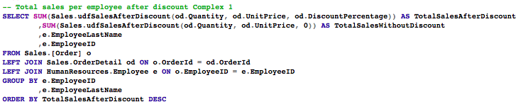
Complex Query 1
Proposition: A business wants to know net sales of an employee after the discount percentage
Query:

Slide 38
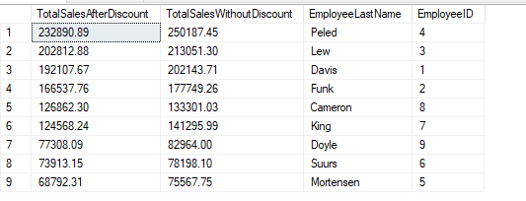
Query in depth
Why: A business can use this to make promotion or termination decisions
Query Result:

Slide 39
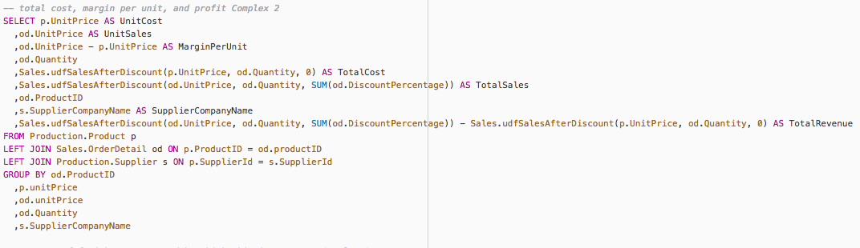
Complex Query 2
Proposition: A business wants to know its total cost, margins per sale per unit, and total profit
Query:

Slide 40
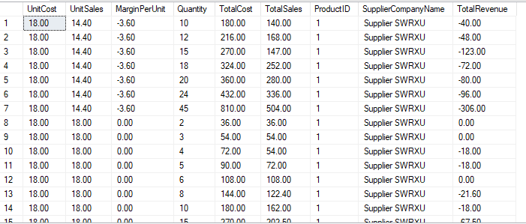
Query in depth
Why: This information is the most important thing while running a businesses.
Query Result:

Slide 41
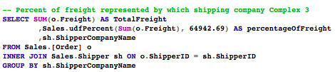
Complex Query 3
Proposition: A business wants to know which shipping company represents what percentage of it's shipment
Query:

Slide 42
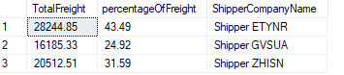
Query in depth
Why: A business would be interested in seeing if they can potentially lower their costs by making a deal with a shipper they use frequently
Query Result:

Slide 43
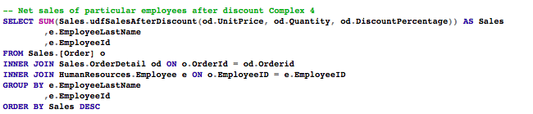
Complex Query 4
Proposition: A business wants to know net sales of all employees after discounts
Query:

Slide 44
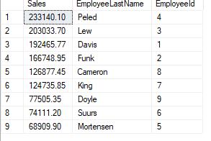
Query in depth
Why: Another situation where a business can use the information from this query to make hiring decisions
Query Result:

Slide 45
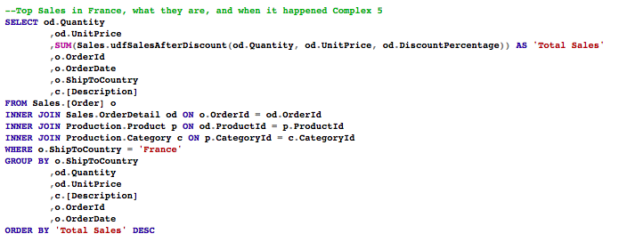
Complex Query 5
Proposition: A business is interested in its top sales in France, and the details about those sales
Query:

Slide 46
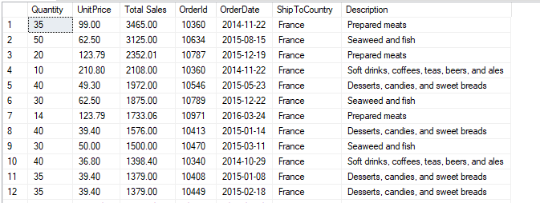
Query in depth
Why: If a business is considering expanding into France or is trying to figure out the solution to a problem with sales in France this information would be helpful
Query Result:

Slide 47
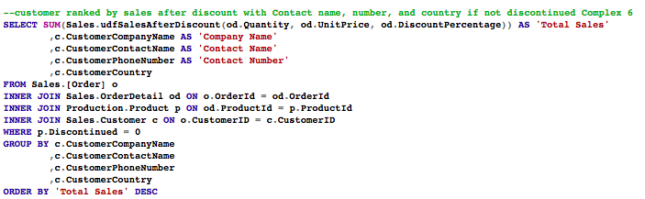
Complex Query 6
Proposition: A business wants to know who it's best and worst customers are and their contact information
Query:

Slide 48
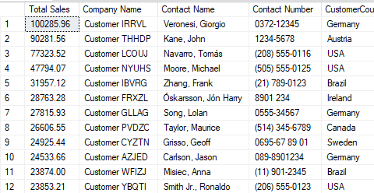
Query in depth
Why: A business could use this to target it's weaker sales or bolster already strong sales to particular clients
Query Result:

Slide 49
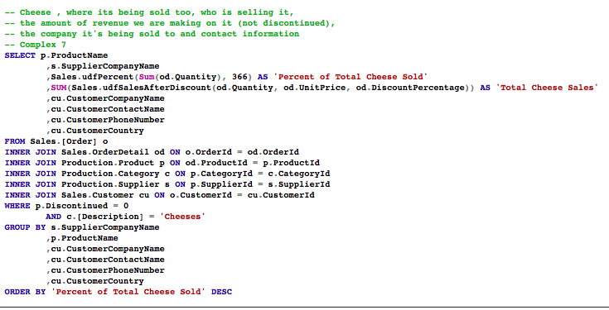
Complex Query 7
Proposition: A business wants to know everything about it's sales on a particular product
Query:

Slide 50
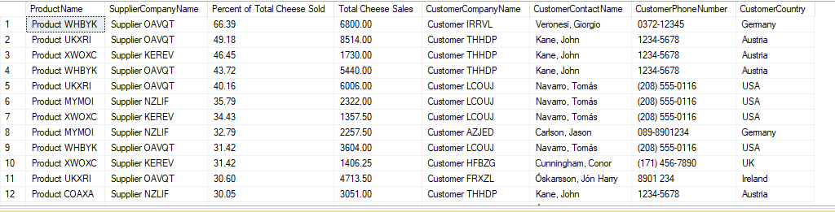
Query in depth
Why: A business can use this to make a myriad of descions regarding the product in question
Query Result:

Slide 51
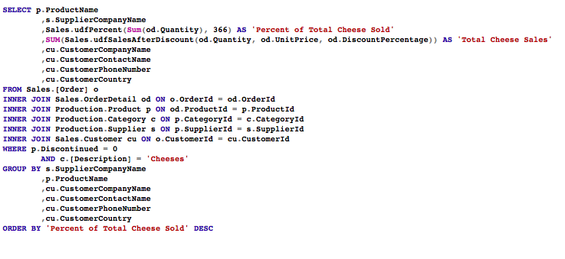
Top Three Queries:
Proposition: Find sales, supplier, percentage of sales and customer information about cheese sales (Complex 7)

Slide 52
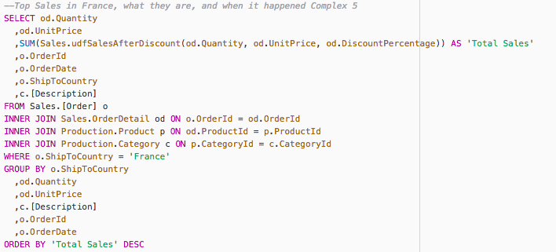
Top Three Queries:
Proposition: Find sales, supplier, total sales of products in France (Complex 5)

Slide 53
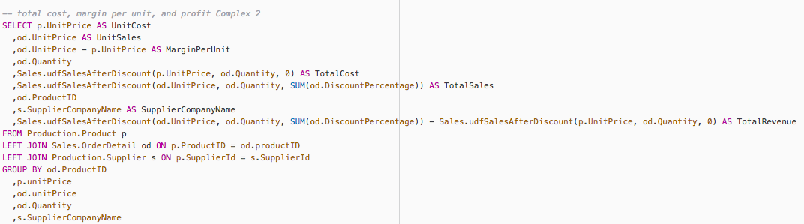
Top Three Queries:
Proposition: Find the total costs, margins, profit, and net profit of the business (Complex 2)

Slide 54
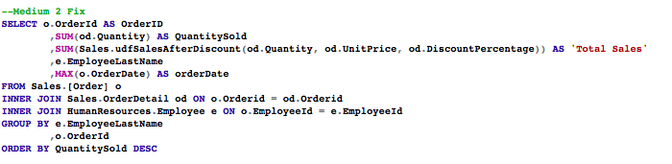
Three Worst Queries With fix
Proposition: Most units sold by an employee in an order (Medium 2)
Original Version
Fixed version

Slide 55
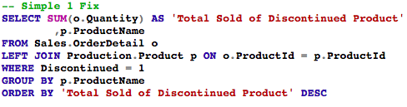
Three Worst Queries With fix
Proposition: Discontinued products and how much they were selling for
Original Version
Fixed version

Slide 56
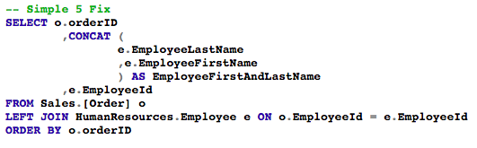
Three Worst Queries With fix
Proposition: Order id per employee
Original Version
Fixed version

Slide 57
Team Effort
My role in the team was to be acting project manager and it was interesting to have to organize the meetings and plan out the tasks. I worked on teams before as a developer and had a project manager and it was a change of pace to see the role from the other side.
I think as a team we worked well for the most part. Particularly we played to each other's strengths, when someone knew how to do something other may not we allowed that person to have thier space and get the task done. I think we also shared the effort evenly.

Slide 58
Alexis Montes– Individual Queries

Slide 59

Query 1: Simple 1
Proposition: Find the list of employees born before the year 2000.
Query:
USE AdventureWorks2014
SELECT NationalIDNumber
,JobTitle
,DATEPART(year, BirthDate) AS [Year Born]
FROM HumanResources.Employee
WHERE DATEPART(year, BirthDate) < 2000;

Slide 60
Query 2: Simple 2
Proposition: Find the employees that were salespersons last year and have made sales year to date that have made more then the previous year
Query:
USE AdventureWorks2014
SELECT BusinessEntityID
,SalesYTD
,SalesLastYear
FROM Sales.SalesPerson
WHERE SalesYTD > SalesLastYear
AND SalesLastYear != 0.00;

Slide 61
Query 3: Simple 3
Proposition: Find the employees that were employed as a technitician based on their job title
Query:
USE AdventureWorks2014
SELECT COUNT(NationalIDNumber) AS [Number of Technicians]
FROM HumanResources.Employee
WHERE JobTitle LIKE '%Technician%';

Slide 62
Query 4: Simple 4
Proposition: Find the list of employees that are paid over $20 and more then once a week
Query:
USE AdventureWorks2014
SELECT BusinessEntityID
,Rate
,PayFrequency
FROM HumanResources.EmployeePayHistory
WHERE Rate > 20
AND PayFrequency > 1;

Slide 63
Query 5: Simple 5
Proposition: Create a list matching the store id and the number of customers that particular store has.
Query:
USE AdventureWorks2014
SELECT StoreID
,COUNT(CustomerID) AS [Number of Customers per store]
FROM Sales.Customer
WHERE (StoreID IS NOT NULL)
GROUP BY StoreID
ORDER BY StoreID;

Slide 64
Query 6: Simple 6
Proposition: Show the list of discounts available sorted by their end date in descending order so that first to end is the first result.
Query:
USE AdventureWorks2014
SELECT [Description]
,[Type]
,DiscountPct AS [Discount Percent]
,EndDate
FROM Sales.SpecialOffer
ORDER BY EndDate DESC;

Slide 65
Query 7: Simple 7
Proposition: Display the list of products that have reviews and display their reviewer(person), their rating and the date it was reviewed
Query:
USE AdventureWorks2014
SELECT P.ProductID
,P.[Name]
,P.ListPrice
,PR.ReviewerName
,PR.Rating
,PR.Comments
,PR.ReviewDate
FROM Production.Product AS P
INNER JOIN Production.ProductReview AS PR ON P.ProductID = PR.ProductID;

Slide 66
Query 8: Simple 8
Proposition: Sort the list of employees by last by last modified date
Query:
USE AdventureWorks2014
SELECT BusinessEntityID
,FirstName
,LastName
,ModifiedDate
FROM Person.Person
ORDER BY ModifiedDate;

Slide 67
Query 9: Simple 9
Proposition: Create a list of Products that have reached their end of sale date, so that it creates a list of discontinued products.
Query:
USE AdventureWorks2014
SELECT ProductID
,[Name]
,SellEndDate
FROM Production.Product
WHERE SellEndDate < SYSDATETIME();

Slide 68
Query 10: Simple 10
Proposition: Find how many products use a specific photo file, that the company uses.
Query:
USE AdventureWorks2014
SELECT COUNT(PPP.ProductPhotoID) AS [Number of Products]
,PPP.ProductPhotoID
,PP.ThumbnailPhotoFileName
FROM Production.ProductProductPhoto AS PPP
INNER JOIN Production.ProductPhoto AS PP ON PPP.ProductPhotoID = PP.ProductPhotoID
GROUP BY PPP.ProductPhotoID
,PP.ThumbnailPhotoFileName;

Slide 69
Query 11: Simple 11
Proposition: Find the top 10 products that have the most quantity in their inventory:
Query:
USE AdventureWorks2014
SELECT TOP (10) ProductID
,Quantity
FROM Production.ProductInventory
ORDER BY Quantity DESC;

Slide 70
Query 12: Simple 12
Proposition: Create a list of products and use a case statement where it printed if the items was in stock or not:
Query:
USE AdventureWorks2014
SELECT ProductID
,CASE
WHEN Quantity = 0
THEN 'Out Of Stock'
ELSE 'In Stock'
END AS [Status]
FROM Production.ProductInventory
ORDER BY ProductID;

Slide 71
Query 13: Medium 1
Proposition: Find the list of employees who have birthdays in March
Query:
USE AdventureWorks2014
SELECT HumanResources.Employee.BusinessEntityID
,BirthDate
,Person.Person.FirstName
,Person.Person.LastName
FROM HumanResources.Employee
INNER JOIN Person.Person ON Person.Person.BusinessEntityID = HumanResources.Employee.BusinessEntityID
WHERE DATEPART(month, BirthDate) = 3
GROUP BY HumanResources.Employee.BusinessEntityID
,Person.Person.FirstName
,Person.Person.LastName
,BirthDate;

Slide 72
Query 14: Medium 2
Proposition: Create a list of products that the company sells and calculate the amount of profit is made on each item
Query:
USE AdventureWorks2014
SELECT P.ProductID
,P.Name
,ProductNumber
,ROUND(P.ListPrice - PCH.StandardCost, 2) AS [Total Profit]
FROM Production.Product AS P
INNER JOIN Production.ProductCostHistory AS PCH ON PCH.ProductID = P.ProductID
GROUP BY P.ProductID
,P.Name
,ProductNumber
,P.ListPrice
,PCH.StandardCost
ORDER BY [Total Profit] DESC;

Slide 73
Query 15: Medium 3
Proposition: Show the list of employees, with the date of their end of 2 week probation and if they are still under probation, by comparing todays date and the date their probation ends
Query:
USE AdventureWorks2014
SELECT E.BusinessEntityID
,P.FirstName
,P.LastName
,E.JobTitle
,E.HireDate
,DATEADD(week, 2, E.HireDate) AS [End of Propation Date]
,CASE
WHEN DATEADD(week, 2, E.HireDate) < SYSDATETIME()
THEN 'Passed'
ELSE 'Still Under'
END AS [Status]
FROM HumanResources.Employee AS E
INNER JOIN Person.Person AS P ON P.BusinessEntityID = E.BusinessEntityID
GROUP BY E.BusinessEntityID
,P.FirstName
,P.LastName
,E.JobTitle
,E.HireDate;

Slide 74
Query 16: Medium 4
Proposition: Create a summery table of Sales persons from within the company, and create a column using a case statement to see if they have met their quota
Query:
USE AdventureWorks2014
SELECT SP.BusinessEntityID
,P.FirstName
,P.MiddleName
,P.LastName
,SP.SalesQuota
,SP.Bonus
,ROUND(SP.SalesYTD, 2) AS [Sales YTD]
,ROUND(SP.SalesLastYear, 2) AS [Sales Last Year]
,CASE
WHEN SalesYTD > SalesQuota
THEN 'Quota Met'
ELSE 'Quota not yet met'
END AS [Quota Status]
FROM Sales.SalesPerson AS SP
INNER JOIN Person.Person AS P ON SP.BusinessEntityID = P.BusinessEntityID
WHERE SP.SalesQuota IS NOT NULL
AND SP.SalesLastYear IS NOT NULL
AND SP.SalesLastYear != 0.00;

Slide 75
Query 17: Medium 5
Proposition: Find how much products were lossed during production of the product with the reason the product was scraped and how much potential revenue was lost.
Query:
SELECT WO.ProductID
,WO.OrderQty
,WO.ScrappedQty
,WO.ScrapReasonID
,SR.[Name]
,P.ListPrice
,ROUND((P.ListPrice * WO.ScrappedQty), 2) AS [Total Loss]
FROM Production.WorkOrder AS WO
INNER JOIN Production.ScrapReason AS SR ON WO.ScrapReasonID = SR.ScrapReasonID
INNER JOIN Production.Product AS P ON WO.ProductID = P.ProductID
WHERE WO.ScrappedQty > 0
AND P.ListPrice != 0.00;

Slide 76
Query 18: Complex 1 part 1
Proposition: Create a summery of employees with their full name created by a function and other details about said employee like their title, department info, and how many times they have been promoted
Query:
USE AdventureWorks2014
SELECT P.FirstName
,P.LastName
, dbo.getFullName(P.FirstName, P.MiddleName, P.LastName) as FullName
,E.JobTitle
,EDH.DepartmentID
,D.Name AS [Current Department]
,P.EmailPromotion AS [Number of Promotions given]
FROM Person.Person AS P
INNER JOIN HumanResources.Employee AS E ON P.BusinessEntityID = E.BusinessEntityID
INNER JOIN HumanResources.EmployeeDepartmentHistory AS EDH ON P.BusinessEntityID = EDH.BusinessEntityID
INNER JOIN HumanResources.Department AS D ON EDH.DepartmentID = D.DepartmentID
WHERE EDH.EndDate IS NULL
GROUP BY P.FirstName
,P.MiddleName
,P.LastName
,E.JobTitle
,EDH.DepartmentID
,D.Name
,P.EmailPromotion;

Slide 77
Query 18: Complex 1 part 2
Function:
CREATE FUNCTION getFullName (
@firstName VARCHAR(250)
,@middleName VARCHAR(250)
,@lastName VARCHAR(250)
)
RETURNS VARCHAR(250)
AS
BEGIN
IF @middleName IS NOT NULL
BEGIN
RETURN CONCAT (
@firstName
,' '
,@middleName
,' '
,@lastName
)
END
RETURN CONCAT (
@firstName
,' '
,@lastName
)
END;
GO

Slide 78
Query 19: Complex 2 part 1
Proposition: Create a summery of salesperson, their sales data from last year, this year and if they can be considered a good salesperson if they have reached their quota plus an additional 15%
Query:
USE AdventureWorks2014
SELECT SP.BusinessEntityID
,ROUND(SP.SalesLastYear, 2) AS [Sales Last Year]
,ROUND(SP.SalesYTD, 2) AS [This Years Sales]
,dbo.goodSalesPerson(ROUND(SP.SalesLastYear, 2), ROUND(SP.SalesYTD, 2)) AS [Is He/She a good salesperson]
,SP.TerritoryID
,ST.Name AS [Territory Name]
,ST.CountryRegionCode
,CR.Name AS [Country Name]
FROM Sales.SalesPerson AS SP
INNER JOIN Sales.SalesTerritory AS ST ON SP.TerritoryID = ST.TerritoryID
INNER JOIN Person.CountryRegion AS CR ON ST.CountryRegionCode = CR.CountryRegionCode
WHERE SP.SalesLastYear != 0.00
GROUP BY SP.BusinessEntityID
,SP.SalesLastYear
,SP.SalesYTD
,SP.TerritoryID
,ST.Name
,ST.CountryRegionCode
,CR.Name
ORDER BY SP.TerritoryID;

Slide 79
Query 19: Complex 2 part 1
Function:
CREATE FUNCTION goodSalesPerson (
@lastYear DECIMAL(10, 2)
,@thisYear DECIMAL(10, 2)
)
RETURNS VARCHAR(250)
AS
BEGIN
IF (@lastYear * 1.15 >= @thisYear)
BEGIN
RETURN 'Excelent'
END
RETURN 'Work In Progress'
END;

Slide 80
Query 20: Complex 3 part 1
Proposition Create a string representation using a function that displays how much the total sale was in the foreign currency used and other details of the sale.
Query:
USE AdventureWorks2014
SELECT SOH.SalesOrderID
,SOH.SalesOrderNumber
,SOH.TerritoryID
,SOH.CurrencyRateID
,SOH.TotalDue AS [Total Due in Dollars]
,CR.ToCurrencyCode
,C.Name
,dbo.getTotalValue(CAST(SOH.CurrencyRateID AS INT), CAST(SOH.TotalDue AS DECIMAL(10, 2))) AS [Total in foregn currency]
FROM Sales.SalesOrderHeader AS SOH
INNER JOIN Sales.CurrencyRate AS CR ON SOH.CurrencyRateID = CR.CurrencyRateID
INNER JOIN Sales.Currency AS C ON C.CurrencyCode = CR.ToCurrencyCode;

Slide 81
Query 20: Complex 3 part 2
Function:
CREATE
OR
ALTER FUNCTION getTotalValue (
@id INT
,@total DECIMAL(10, 2)
)
RETURNS VARCHAR(250)
AS
BEGIN
DECLARE @toRate DECIMAL(10, 2)
,@finalAmt DECIMAL(10, 2)
,@CName VARCHAR(250)
SET @toRate = CAST((
SELECT AverageRate
FROM Sales.CurrencyRate
WHERE CurrencyRateID = @id
) AS INT);
SET @finalAmt = @total * @toRate;
SET @CName = (
SELECT ToCurrencyCode
FROM Sales.CurrencyRate
WHERE @id = CurrencyRateID
)
RETURN CONCAT (
CAST(@finalAmt AS VARCHAR(250))
,' '
,CAST((
SELECT NAME
FROM Sales.Currency
WHERE @CName = CurrencyCode
) AS VARCHAR(250))
,'s'
)
END;

Slide 82
Best 3 Personal Queries
Query 16
Proposition: Create a summery table of Sales persons from within the company, and create a column using a case statement to see if they have met their quota.
Query 19
Proposition: Create a summery of salesperson, their sales data from last year, this year and if they can be considered a good salesperson if they have reached their quota plus an additional 15%
Query 20
Proposition Create a string representation using a function that displays how much the total sale was in the foreign currency used and other details of the sale.

Slide 83
Best 3: Query 16
Reason:
In terms of simplicity the code is pretty straight forward where we look at the standards we set for our code. Where it doesn't over complicate things and does what it is supposed to do.

Slide 84
Best 3: Query 19
Reason:
Using a scalar function this takes in the sales person’s data for sales for the current year and last year. Using this it returns back a string value based on if a person beat their quota by 15%, in a pretty straight forward way, without causing the function to become overly complicated.

Slide 85
Best 3: Query 20
Reason:
The Query requires only two values that need to be passed over to find out what the total foreign currency was paid. The currency conversion id and the total sale. The rest is taken care of from within the function such as finding out what currency was used using sql syntax and then converted into the result in one cohesive string that was printed with the rest of the retrieved info.

Slide 86
Worst 3 Personal Queries.
Query 1
Proposition: Find the list of employees born before the year 2000
Query 18
Proposition: Create a summery of employees with their full name using concatenation in a function, and other details like job title, department info and how many times they have been promoted.
Query 8
Proposition: Sort the list of employees by last modified date

Slide 87
Worst 3: Query 1
Reason:
We as a group set standards that put clean readable code as an important standard, and to that respect it is simple, but it is too simple where the query as a whole does not do much, and doesn’t really retrieve any companion info to help make it a useful query.

Slide 88
Worst 3: Query 18
Reason:
The premise for the query seems simple, but it is an overly complicated way to solve this issue where the entire function can be easily replaced by a case statement to preserve the middle initial or just ignoring it and just merging the first and last name. Where it goes against our standards for code that is not too complicated.

Slide 89
Worst 3: Query 8
Reason:
The main reason for this query to be considered bad is in how the data it retrieves is not really useful by itself. It can’t really be used to calculated when the employee was hired since the modified data could have been changed when an employees personal information changed in the database.

Slide 90
Komal Narine– Individual Queries

Slide 91
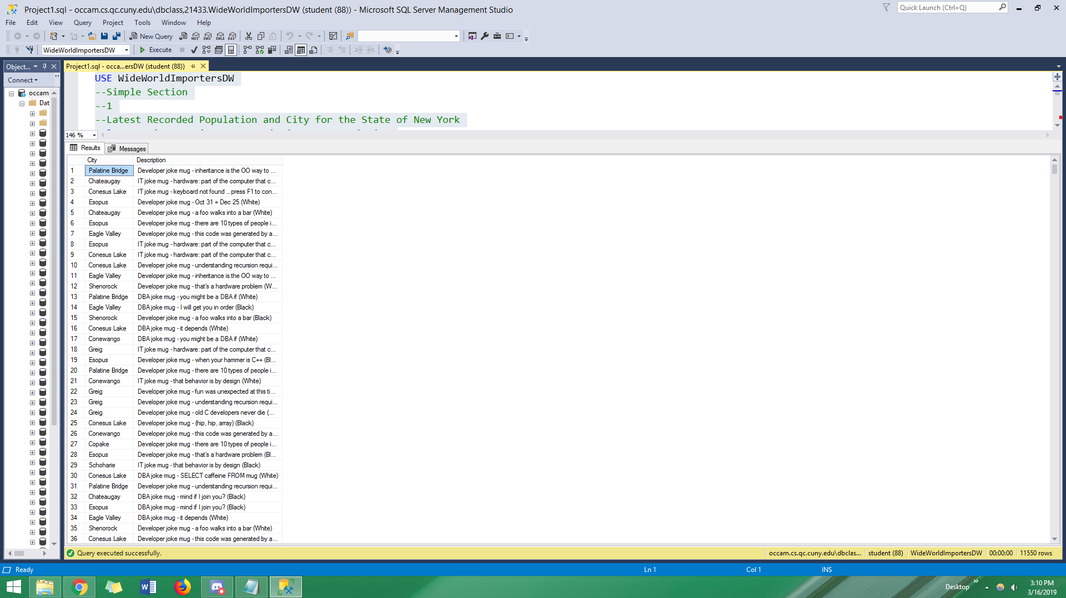
--Latest Recorded Population and City for the State of New York
SELECT C.City AS City
,O.Description AS Description
FROM Dimension.City AS C
INNER JOIN Fact.[Order] AS O ON C.[City Key] = O.[City Key]
WHERE C.[State Province] = 'New York';

Slide 92

--2
--Name of Item and the amount that has been moved.
SELECT S.[Stock Item] AS ItemName
,M.Quantity AS Amount
FROM Dimension.[Stock Item] AS S
INNER JOIN Fact.[Movement] AS M ON S.[Stock Item Key] = M.[Stock Item Key];

Slide 93

--3
--City and Description of order, made from that city.
SELECT C.City AS City
,O.Description AS Description
FROM Dimension.City AS C
INNER JOIN Fact.[Order] AS O ON C.[City Key] = O.[City Key];

Slide 94

--4
--Customer and category exclusively in Dimension.Customer and not in Fact.Sale
SELECT Customer
,Category
FROM Dimension.Customer AS C
LEFT JOIN Fact.Sale AS S ON C.[Customer Key] = S.[Customer Key]
WHERE S.[Customer Key] IS NULL;

Slide 95

--5
--All sales made by all employees
SELECT *
FROM Dimension.Employee AS E
INNER JOIN Fact.Sale AS S ON E.[Employee Key] = S.[Salesperson Key];

Slide 96

--Moderate
--1
--Total Sales made by each Employee
SELECT E.Employee
,Count(S.[Sale Key]) AS Sales
FROM Dimension.Employee AS E
INNER JOIN Fact.Sale AS S ON E.[Employee Key] = S.[Salesperson Key]
GROUP BY E.Employee;

Slide 97

--2
--The name of the Customer, Category,and Post Code of Customers who made transactions with EFT
SELECT C.Customer
,C.Category
,C.[Postal Code]
,Count(C.[Customer Key]) AS Transactions
FROM Dimension.[Payment Method] AS P
INNER JOIN Fact.[Transaction] AS T ON P.[Payment Method Key] = T.[Payment Method Key]
INNER JOIN Dimension.Customer AS C ON C.[Customer Key] = T.[Customer Key]
WHERE P.[Payment Method] = 'EFT'
AND C.Customer != 'Unknown'
GROUP BY C.Customer
,C.Category
,C.[Postal Code];

Slide 98

--3
--Name and Quantity of Items sold in Total.
SELECT S.[Stock Item] AS Item
,Sum(O.Quantity) AS Amount
FROM Dimension.[Stock Item] AS S
INNER JOIN Fact.[Order] AS O ON S.[Stock Item Key] = O.[Stock Item Key]
GROUP BY S.[Stock Item];

Slide 99

--4
--Number of Customers in a given City
SELECT C.City AS City
,Count(O.[Customer Key]) AS NumberofCustomers
FROM Dimension.City AS C
INNER JOIN Fact.[Order] AS O ON C.[City Key] = O.[City Key]
GROUP BY C.City;

Slide 100

--5
--The Item and Average Amount of that Item that is moved
SELECT S.[Stock Item] AS ItemName
,AVG(M.Quantity) AS AverageAmount
FROM Dimension.[Stock Item] AS S
INNER JOIN Fact.[Movement] AS M ON S.[Stock Item Key] = M.[Stock Item Key]
GROUP BY S.[Stock Item];

Slide 101

--6
--Products and the largest order of each
SELECT P.EnglishProductName AS Name
,Max(S.OrderQuantity) AS LargestOrder
FROM dbo.DimProduct AS P
INNER JOIN dbo.FactResellerSales AS S ON P.ProductKey = S.ProductKey
GROUP BY P.EnglishProductName;

Slide 102

--7
--Employee,Department,Country,Group, Region, and Sales in each SalesTerritory,and all sales made by employee
SELECT CONCAT (
E.FirstName
,E.LastName
) AS Name
,E.DepartmentName
,T.SalesTerritoryCountry AS Country
,T.SalesTerritoryGroup AS [Group]
,T.SalesTerritoryRegion AS Region
,Sum(SalesAmount) AS TotalSales
FROM dbo.DimEmployee AS E
INNER JOIN dbo.FactResellerSales AS S ON E.EmployeeKey = S.EmployeeKey
INNER JOIN dbo.DimSalesTerritory AS T ON S.SalesTerritoryKey = T.SalesTerritoryKey
GROUP BY CONCAT (
E.FirstName
,E.LastName
)
,E.DepartmentName
,T.SalesTerritoryCountry
,T.SalesTerritoryGroup
,T.SalesTerritoryRegion;

Slide 103

--8
--Products that haven't been sold by Reseller, Key and Name of Product
SELECT DISTINCT P.ProductKey
,Pd.EnglishProductName AS Name
FROM dbo.FactProductInventory AS P
LEFT JOIN dbo.FactResellerSales AS S ON P.ProductKey = S.ProductKey
INNER JOIN dbo.DimProduct AS Pd ON P.ProductKey = Pd.ProductKey
WHERE S.ProductKey IS NULL
ORDER BY P.ProductKey;

Slide 104

--Complex
--1
SELECT FirstName
,LastName
,dbo.Initials(FirstName, LastName) AS Initials
,SUM(S.SalesAmount) AS TotalCostInPurchases
FROM dbo.DimCustomer AS C
INNER JOIN dbo.FactInternetSales AS S ON S.CustomerKey = C.CustomerKey
INNER JOIN dbo.DimPromotion AS P ON P.PromotionKey = S.PromotionKey
WHERE S.PromotionKey != 1
GROUP BY FirstName
,LastName
,dbo.Initials(FirstName, LastName);

Slide 105

--2
SELECT E.FirstName
,E.StartDate
,dbo.YearsWorking(E.StartDate, E.EndDate) AS YearsWorking
,T.SalesTerritoryGroup
,Count(S.ProductKey) AS Sales
FROM dbo.DimEmployee AS E
INNER JOIN dbo.FactResellerSales AS S ON E.EmployeeKey = S.EmployeeKey
INNER JOIN dbo.DimSalesTerritory AS T ON S.SalesTerritoryKey = T.SalesTerritoryKey
GROUP BY E.FirstName
,E.StartDate
,E.EndDate
,T.SalesTerritoryGroup
ORDER BY E.StartDate
,YearsWorking
,T.SalesTerritoryGroup;

Slide 106

--3
SELECT R.ResellerName AS NameofReseller
,dbo.Initials(E.FirstName, E.LastName) AS EmployeeInitials
,Max(S.OrderQuantity) AS LargestOrder
FROM dbo.DimReseller AS R
INNER JOIN dbo.FactResellerSales AS S ON R.ResellerKey = S.ResellerKey
RIGHT JOIN dbo.DimEmployee AS E ON E.EmployeeKey = S.EmployeeKey
GROUP BY R.ResellerName
,E.FirstName
,E.LastName;

Slide 107

--4
SELECT R.ResellerName AS NameofReseller
,dbo.Initials(E.FirstName, E.LastName) AS EmployeeInitials
,Max(S.OrderQuantity) AS LargestOrder
FROM dbo.DimReseller AS R
INNER JOIN dbo.FactResellerSales AS S ON R.ResellerKey = S.ResellerKey
INNER JOIN dbo.DimEmployee AS E ON E.EmployeeKey = S.EmployeeKey
WHERE dbo.IS_MALE(E.Gender) = 1
GROUP BY R.ResellerName
,E.FirstName
,E.LastName
ORDER BY LargestOrder DESC;

Slide 108

--5
SELECT P.ProductKey
,P.MovementDate AS DateMoved
,Count(Pd.ProductKey) AS AmountMoved
,Pd.EnglishProductName AS Name
FROM dbo.FactProductInventory AS P
INNER JOIN dbo.FactResellerSales AS S ON P.ProductKey = S.ProductKey
INNER JOIN dbo.DimProduct AS Pd ON P.ProductKey = Pd.ProductKey
WHERE dbo.In_Year(P.MovementDate, 2011) = 1
GROUP BY P.ProductKey
,P.MovementDate
,Pd.EnglishProductName;

Slide 109

--6
SELECT dbo.Initials(C.FirstName, C.LastName) AS CustomerInitials
,Sum(P.StandardCost) AS TotalCostOfProductsBought
FROM dbo.DimCustomer AS C
INNER JOIN dbo.FactInternetSales AS S ON S.CustomerKey = C.CustomerKey
INNER JOIN dbo.DimProduct AS P ON P.ProductKey = S.ProductKey
GROUP BY FirstName
,LastName
ORDER BY TotalCostOfProductsBought DESC;

Slide 110

--7
SELECT dbo.Initials(C.FirstName, C.LastName) AS CustomerInitials
,Sum(P.StandardCost) AS TotalCostOfProductsBought
FROM dbo.DimCustomer AS C
INNER JOIN dbo.FactInternetSales AS S ON S.CustomerKey = C.CustomerKey
INNER JOIN dbo.DimProduct AS P ON P.ProductKey = S.ProductKey
WHERE dbo.IS_MALE(C.Gender) = 0
GROUP BY FirstName
,LastName
ORDER BY TotalCostOfProductsBought DESC;

Slide 111
The Team's combined queries
The team picked the top 3 and worst queries according to the following criteria:
A good query meets it's specifications
A good query uses code that is legible and non-superfluous
The tools used are appropriate for the task and not complex for the sake of complexity
Clever use of code is always a bonus but not the end goal

Slide 112

Top Three Queries:
Alexis Montes Medium 4 Query
Proposition: Create a sales summary of the sales team with an extra column checking if an employee has exceeded his or her sales quota

Slide 113

Top Three Queries:
Komal Narine Medium Query 7
Proposition: Find the sales information about each employee per region

Slide 114
Top Three Queries:
Julien Bankier Medium Query

Slide 115


Three Worst Queries With fix
Querry: Julien Bankier Simple
Proposition: Order id with first and last name of employees
Original Version
Fixed version

Slide 116


Three Worst Queries With fix
Query: Komal Norine Simple 5
Proposition: All Sales by all Employees
Original Version
Fixed version

Slide 117


Three Worst Queries With fix
Query: Julien Bankier Medium 1
Proposition: Total discount percentage per item sold
Original Version
Fixed version

